Slide 1
OFDM TRANSMITTER

Slide 2
Basic Principle of OFDM - MCM
Assume a single carrier wave of bandwidth B(value is too high).
To send the signal properly, the delay spread should be less than the symbol rate which is 1/B.
If it’s not the case “Intersymbol Interference” takes place.
To overcome the problem, divide the signal in smaller bands each of a bandwidth B/N-Multi carrier system.
At the receiver to get back the symbols, we can coherently demodulate the corresponding subcarrier. All subcarriers except ith subcarrier are orthogonal to the subcarrier.----->(Orthogonal)
Challenges in MCM-The number of modulators and demodulators scale proportionally to the number of subcarriers.

Slide 3
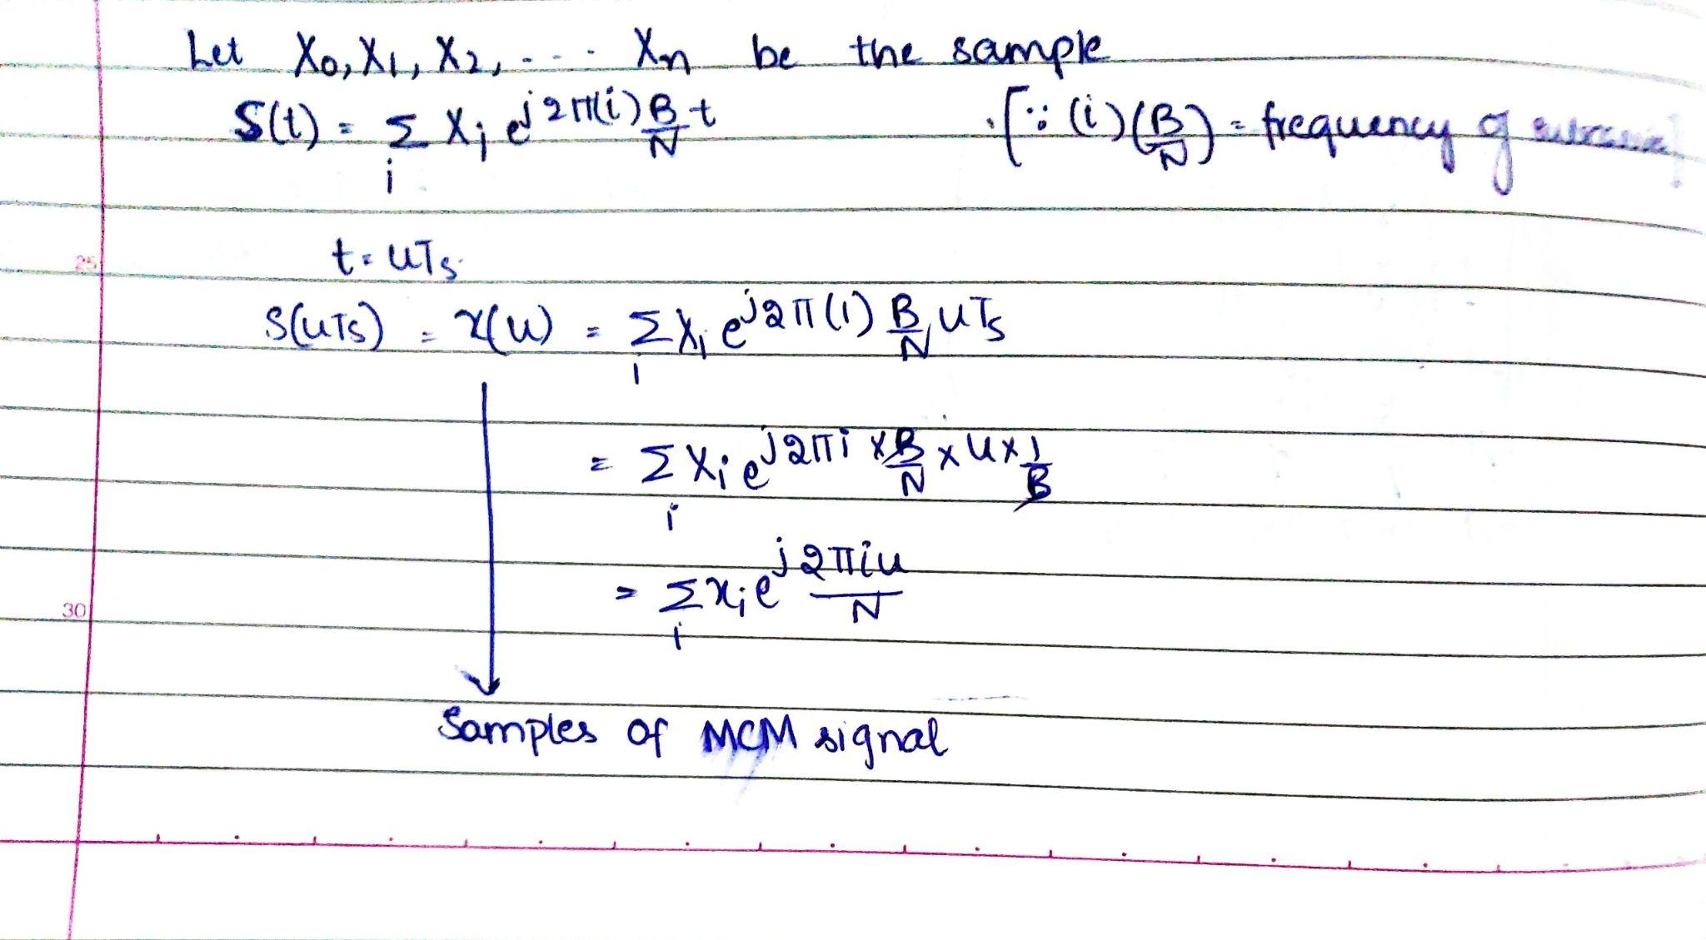
Data transmission by Frequency Division Multiplexing using DFT
Since the signal is bandlimited to B, by nyquist sampling criterion the sampling time is 1/B.

Slide 4
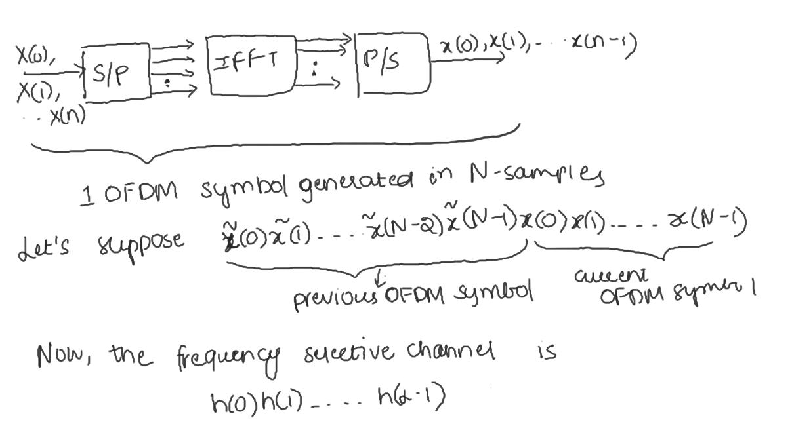
Cyclic Prefix:

Slide 5
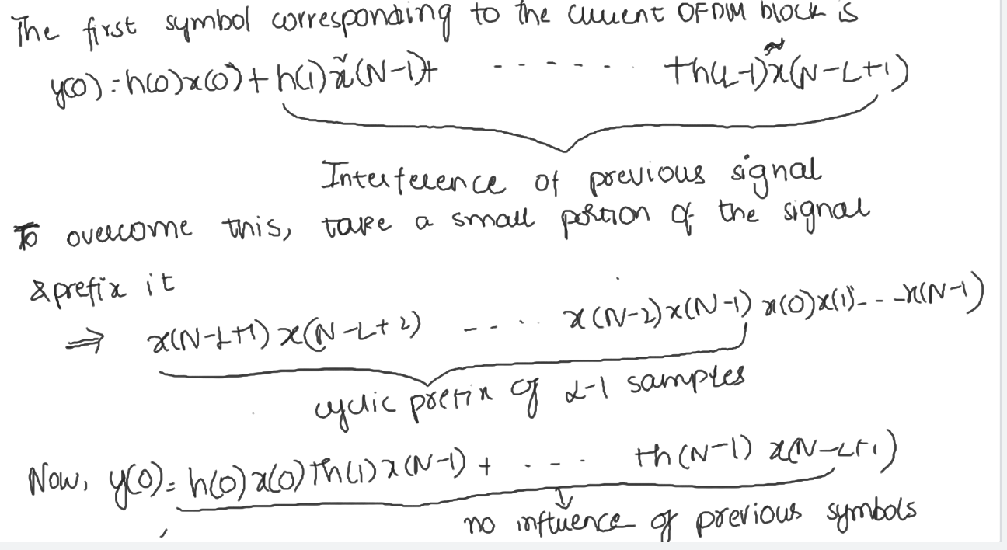

Slide 6
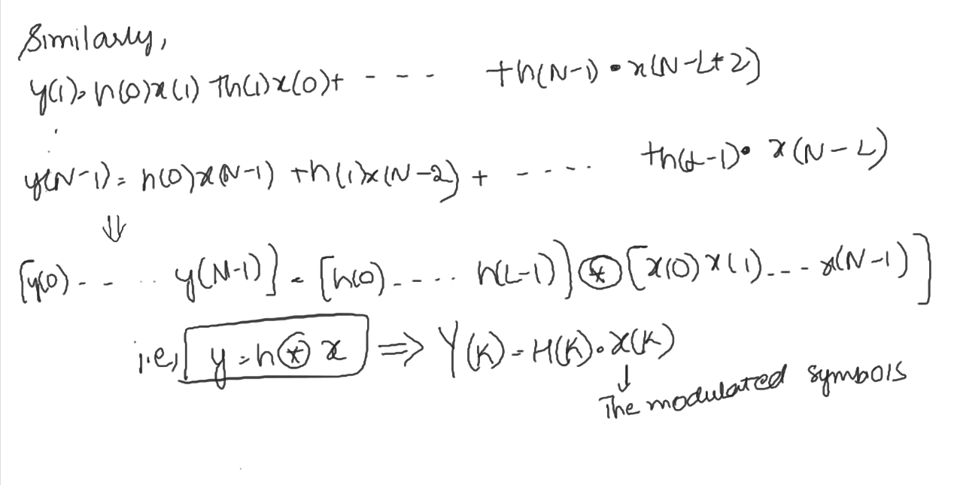

Slide 7
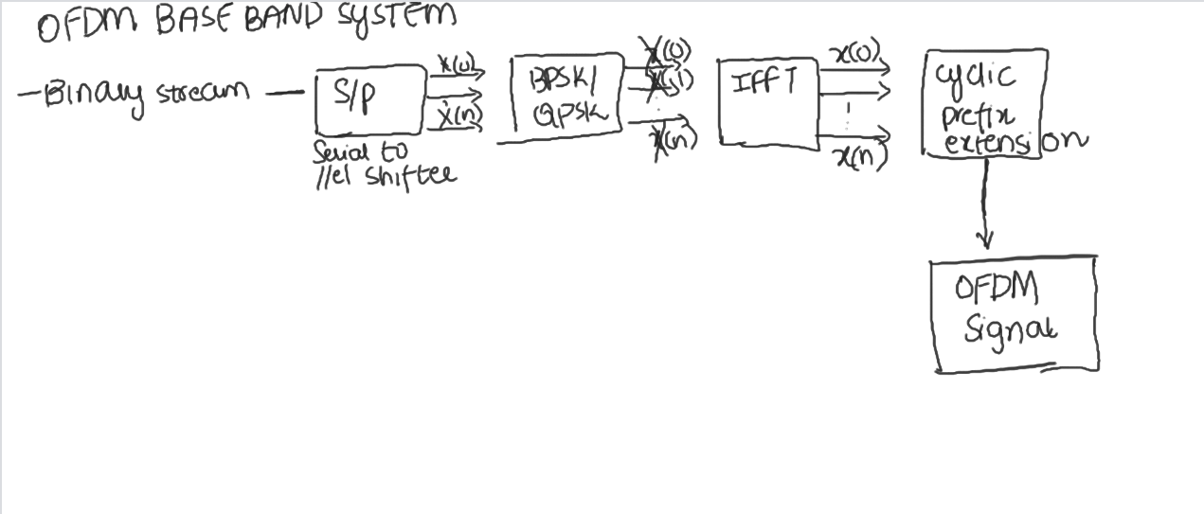
Block Diagram of OFDM:

